Slide 1

From Voice to Information
A Journey presented by Logan Clark, Vedas Sandeep Paktor, and Lennart Zeugner

Slide 2
Audio as Vehicle of Information Transfer
Importance of Audio
Today, digital audio files are arguably the most important data format for information transportation
From podcasts, over audio books and news channels, to YouTube videos
→ Audio Files are everywhere
Yet, we lack the ability to extract information efficiently
Can we build a generalizable pipeline to extract value from Digital Audio files?

Slide 3
From Audio to Information
Data Workflow
Steps
Tools
1
Download Audio File
Youtube_dl Package
2
Audio to Text Conversion
Speech Recognition Package
3
Text Preprocessing
Apply Regex and Punctuator
4
Sentiment Analysis
NLTK and Vader Library
5
Extraction Based Summarization
Aylien – a RNN based API

Slide 4






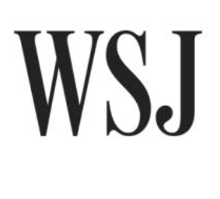



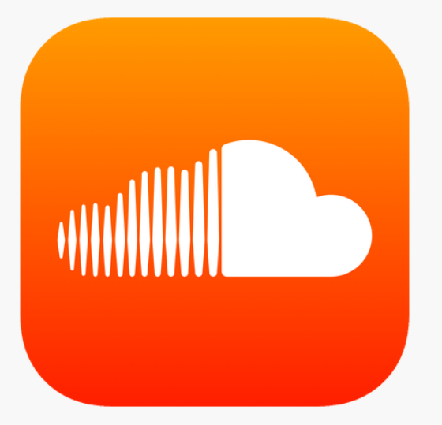
Get Audio from Everywhere
Data Retrieval
With the Youtube_dl package we can download audio and video files from a URL and convert to a .wav file
We can specify both output name and format
Youtube_dl supports an extensive collection (~ 240) of websites

Slide 5

From Audio to Text
Data Conversion
We can use the Python - Speech_Recognition package to transcribe .wav file to .txt files
Drawbacks
Speech recognition function has a time restriction of about 2 minutes
→ Split audio file into multiple smaller chunks
During the conversion process we miss out on punctuation
→ summarization becomes hard

Slide 6
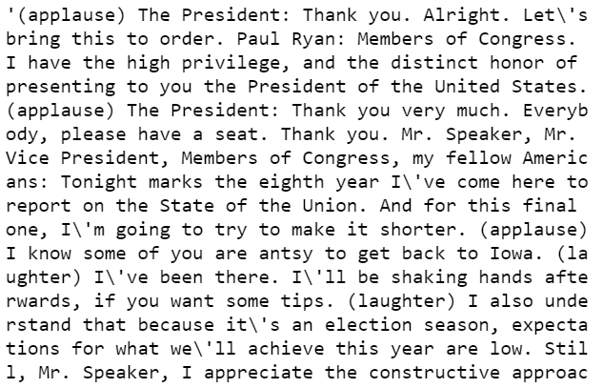
Making Text Analyzable
Join text files to one coherent text
Text Preprocessing
Join the various text files into one coherent text
Eliminate non-spoken content such as applause, noise, or music by applying regex pattern
Add punctuation using the Punctuator API, which makes use of an LSTM neural network
Tokenize Sentences with NLTK for Sentiment Analysis

Slide 7

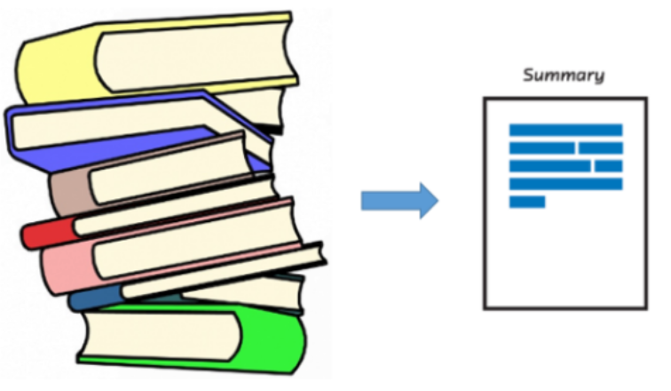
Extracting Information
Perform extraction based summarization with the help of the Aylien text API
Aylien text API allows us to easily summarize and extract the key sentences from a piece of text.
We can reduce the length of the original text by providing a specific desired number of sentences
Aylien makes use of recurrent neural networks in order to execute NLP task such as summarization
Sentiment Analysis
Extraction Based Summarization
Perform Sentiment Analysis with Vader library
Vader is a lexicon and rule-based sentiment analysis tool
Accounts for intensity (e.g. very very smart)
Considers negation
Handles punctuation
Vader provides three labels
Positive = ratio of positive words in sentence
Negative = ratio of negative words in sentence
Compound = rule-based adjusted score
All scores are normalized between -1 and 1

Slide 8
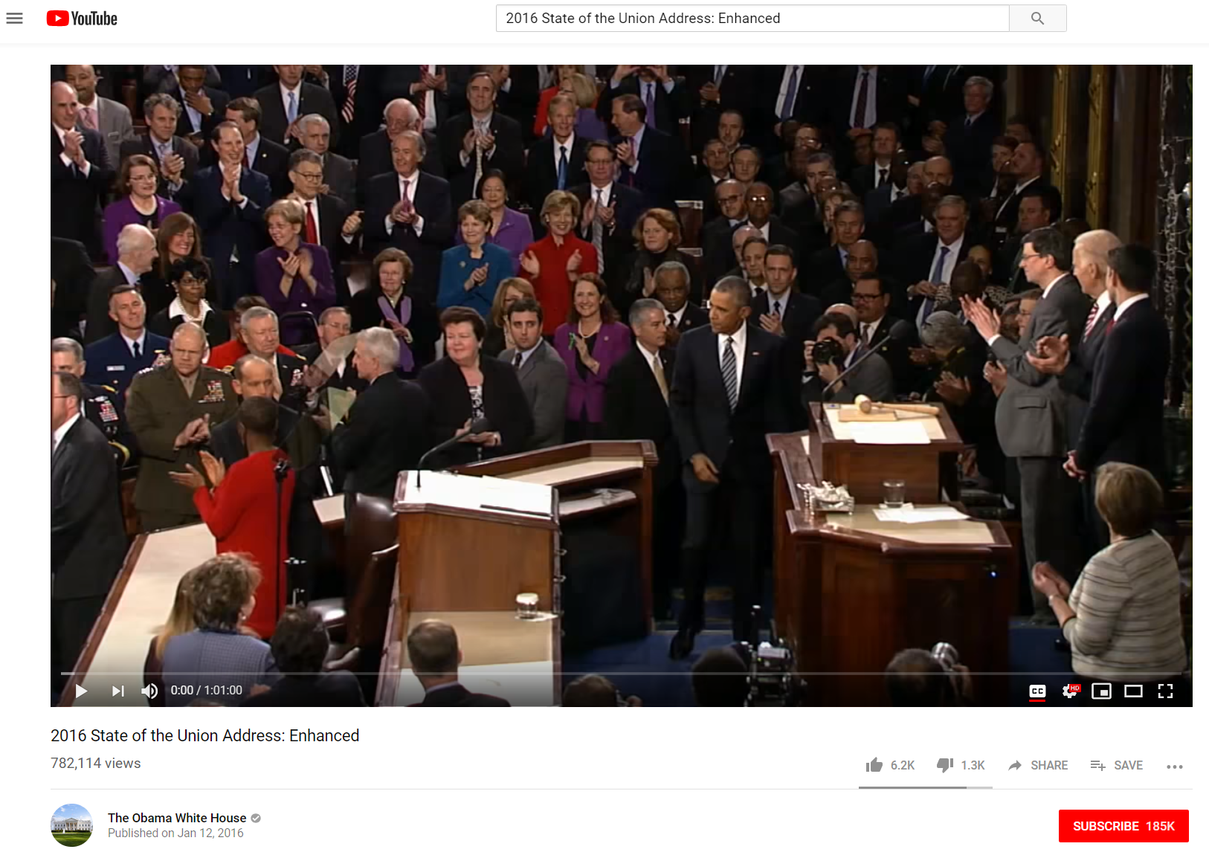
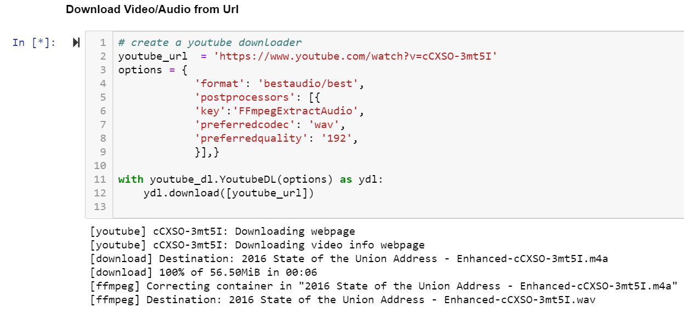
How real world application could look like…
Application Implementation – Data Retrieval
State of the Union Speech - 2016
Download Audio

Slide 9
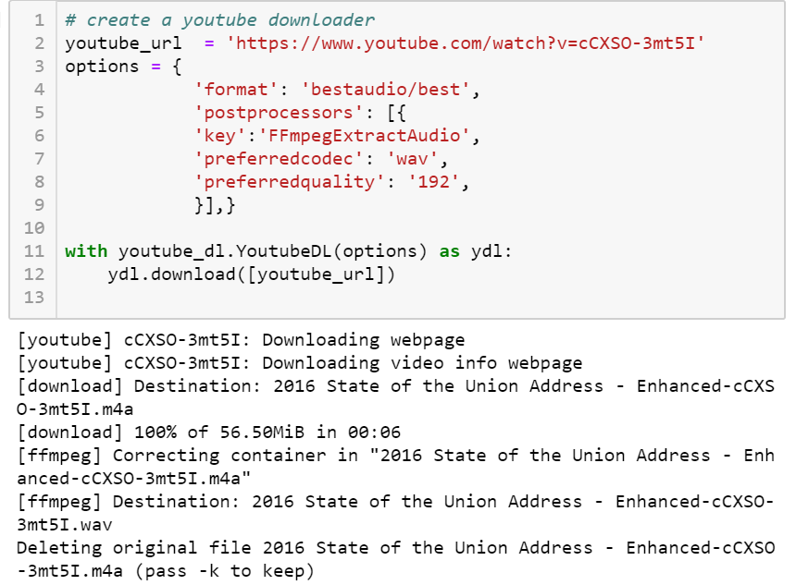
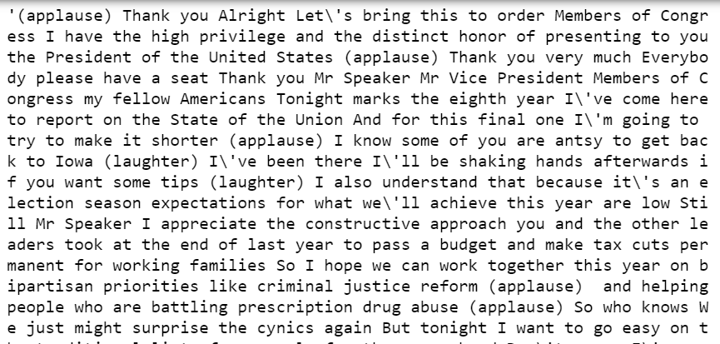
How real world application could look like…
Application Implementation – Audio Transcription
Transcription

Slide 10
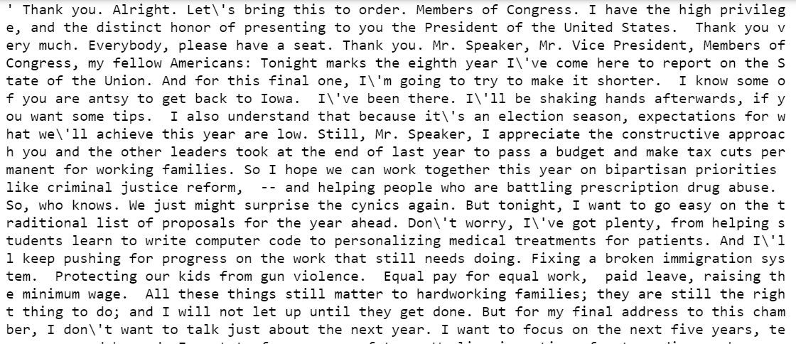
How real world application could look like…
Application Implementation – Text Preprocessing
Apply Regex Filter
Add Punctuation

Slide 11
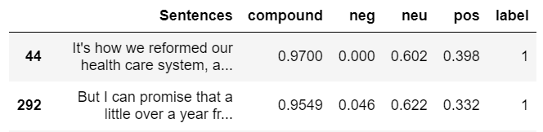
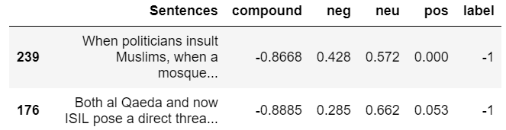
How real world application could look like…
Application Implementation – Sentiment Analysis
Positive Sentences
Negative Sentences
1) It's how we reformed our health care system, and reinvented our energy sector; -how we delivered more care and benefits to our troops and veterans, that's how we secured the freedom in every state to marry the person we love.
2) But I can promise that a little over a year from now, when I no longer hold this office, I will be right there with you as a citizen - inspired by those voices of fairness and vision, of grit and good humor and kindness that have helped America travel so far.
When politicians insult Muslims, when a mosque is vandalized, or a kid bullied, that doesn't make us safer.
2) Both al Qaeda and now ISIL pose a direct threat to our people, because in today's world, even a handful of terrorists who place no value on human life, including their own, can do a lot of damage.

Slide 12
How real world application could look like…
Summary:
Mr. Speaker, Mr. Vice President, Members of Congress, my fellow Americans: Tonight marks the eighth year I've come here to report on the State of the Union. Still, Mr. Speaker, I appreciate the constructive approach you and the other leaders took at the end of last year to pass a budget and make tax cuts permanent for working families. America has been through big changes before - wars and depression, the influx of immigrants, workers fighting for a fair deal, and movements to expand civil rights. Each time, there have been those who told us to fear the future; who claimed we could slam the brakes on change, promising to restore past glory if we just got some group or idea that was threatening America under control. We made change work for us, always extending America's promise outward, to the next frontier, to more and more people. In fact, it's that spirit that made the progress of these past seven years possible. Will we respond to the changes of our time with fear, turning inward as a nation, and turning against each other as a people? First, how do we give everyone a fair shot at opportunity and security in this new economy? Let me start with the economy, and a basic fact: the United States of America, right now, has the strongest, most durable economy in the world. More than 14 million new jobs; the strongest two years of job growth since the '90s; an unemployment rate cut in half. That's just part of a manufacturing surge that has created nearly 900,000 new jobs in the past six years. What is true - and the reason that a lot of Americans feel anxious - is that the economy has been changing in profound ways, changes that started long before the Great Recession hit and haven't let up. All these trends have squeezed workers, even when they have jobs; even when the economy is growing. For the past seven years, our goal has been a growing economy that works better for everybody. In the coming years, we should build on that progress, by providing Pre-K for all, -- offering every student the hands-on computer science and math classes that make them job-ready on day one, and we should recruit and support more great teachers for our kids. Providing two years of community college at no cost for every responsible student is one of the best ways to do that, and I'm going to keep fighting to get that started this year. After all, it's not much of a stretch to say that some of the only people in America who are going to work the same job, in the same place, with a health and retirement package, for 30 years, are sitting in this chamber. It's about filling the gaps in employer-based care so that when we lose a job, or go back to school, or start that new business, we'll still have coverage. Say a hardworking American loses his job - we shouldn't just make sure he can get unemployment insurance; we should make sure that program encourages him to retrain for a business that's ready to hire him. If that new job doesn't pay as much, there should be a system of wage insurance in place so that he can still pay his bills. That's the way we make the new economy work better for everyone.
Application Implementation - Summarization

Slide 13
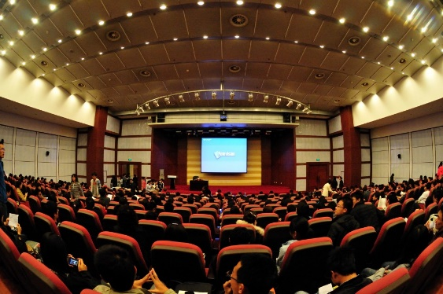
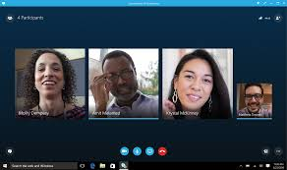
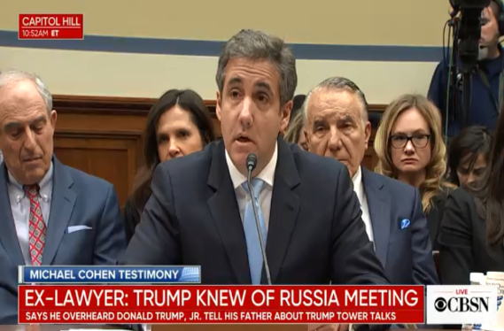
How does this application add value?
Real World Applications
Lectures
Business Meetings
News
Convert and summarize lecture recordings in case you missed class
Summarize content of a recorded business meeting to capture important parts
Summarize long videos such as congressional hearings to capture the main ideas without watching

Slide 14
Resources:
https://www.nltk.org/_modules/nltk/sentiment/vader.html
https://pypi.org/project/youtube_dl/
https://aylien.com/text-api/summarization/
https://www.w3schools.com/python/python_regex.asp
https://github.com/ottokart/punctuator2
Thank you – Question?

